Slide 1
SP3d – FO1.2b Test Case Design Flow
Prepared on 23 Dec 2019

Slide 2
Test Design Team Deliverables
Virtual Team
Requirement Grooming
Architecture Runway
Requirement
Study
Doc Preparation
Coding Development
Dev Test Entry Evaluation
Dev Test
Cycle 0
Dev Test
Cycle 1
Integration Test
1st Phase: With FO System Only
2nd Phase: With Non-FO Systems (Selected Channels)
Per BP Level
Deliver in FR Base and follow VT Batch as priority
Deliver in BP Level
Preparation and Target Deliverables:
Behavior Test Cases (Positive Main Flow) [BTC - 1st Draft]
Knowledge Sharing Session for enter VT team
Target Deliverables:
Behavior Test Cases (with UI Screen Menu Path & UI System Solution Checking) [BTC -2nd Draft]
Target Deliverables:
Critical Set of BTC
Critical Set of System Case (if applicable)
Target Deliverables:
Full Set BTC [3rd Draft]
High Level System Cases
Target Deliverables:
Full Set System Cases for whole BP [STC – 2st Draft]
Target Deliverables:
Full Set Integration Cases [ITC – 1st Draft]
Full Set Scenario related to this BP
Keep update and refinement
System Cases
Integration Cases
Operation Scenario
API / UI Automation based on BTC
API / UI Automation based on System TC
Preparation:
System Cases for whole BP / cross BP
Integration Cases with FO systems
Integration Cases with Non-FO systems
Operation Scenario

Slide 3
Test Design Example – Different Test Cases Type
Start Sell Pool and Place Bets from Downstream Channels
BTC for EDS:
Create Event Profile – Team A vs Team B
System Test Case 1:
Create 1 Event Profile with HAD and CRS
Integration Test Case 1 (FO System Level/ Win++ Level):
Check ACP and AGP are Started Sell after Start Sell Match with HAD and CRS for TB Channel
BTC for BTS:
Add Bet Type – HAD and CRS
Follow Defined FB Lifecycle
BTC for OCF:
Odds Finalization – HAD and CRS
System Test Case 2:
Check Pre-event Traders Assignment
for Event Profile with HAD and CRS
Integration Test Case 2 (FO System Level/ Win++ Level):
Check CAP IDA-FB received Match Start Sell with HAD and CRS for TB Channel
BTC for TTA:
Check at least Two Traders are assigned to Event Profile
BTC for MSSS:
Channel user define TB Selling Business Hours – 12:00 to 23:00
System Test Case 3:
Start Sell Match with HAD and CRS with Frontend ID is defined
Integration Test Case 3 (Non-FO System Level):
Check TBTN received FBXXXX Match Start Sell with HAD and CRS and can place bet
BTC for MSSS:
BOCC Start Sell Event Profile – Team A vs Team B at 12:00
Behavior Test Case Level
System Test Case
Integration Test Case

Slide 4
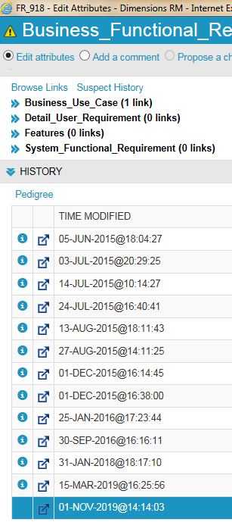
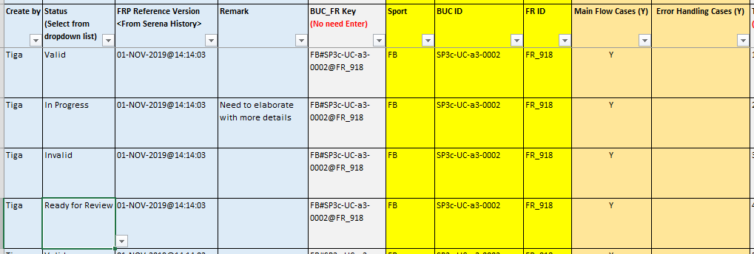
Behavior Test Case Creation – 1/4
Input View - Test Case Basic Information:
Design Doc Reference:
Business & Functional Requirement Doc, Message and Task Summary, RnR Matrix, Field Spec, Product Matrix, Data Init Files
Highlight:
Status:
Valid:
In Progress:
Invalid:
Ready for review:
FRP Reference Version: From FR’s Serena History Details
Remark: for us to enter some remark/notes
Error Handling Case: Negative Test Case/Derive Case

Slide 5
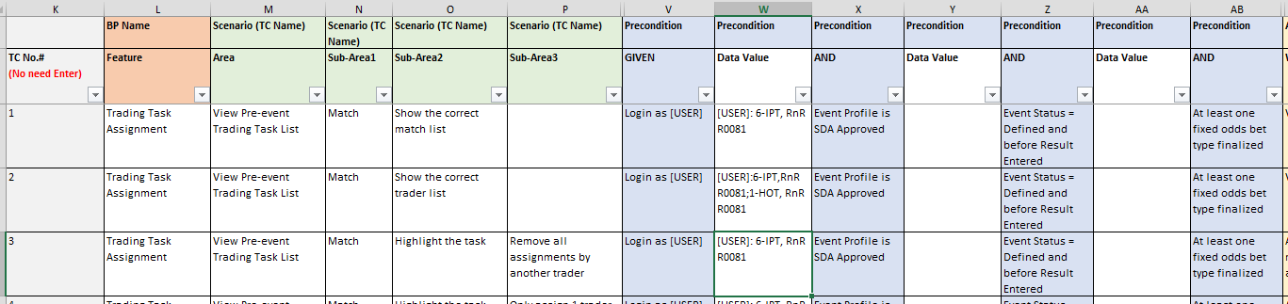
Behavior Test Case Creation – 2/4
Framework:
Feature: Business Process Story
Scenario: Header which describes the scenario you’re interested in
GIVEN (describing the context)
WHEN (describing the action)
THEN (describing the outcome)
Highlight:
Scenario will be combined from Area and Sub-Area columns
Precondition may have more than one, separate into different AND columns
All data value enter into the Data Value column, use “[ ]” as the data variable
E.g. [DATA VARIABLE]:toppyshli,RnR R0081
If more than 1 data, use “;” to separate them
- E.g. [DATA VARIABLE]:toppyshli,RnR R0081;kaemankmchan,RnR R0081

Slide 6
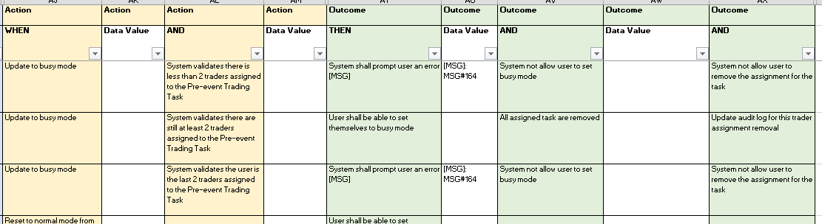
Behavior Test Case Creation – 3/4
Framework:
Feature: Business Process Story
Scenario: Header which describes the scenario you’re interested in
GIVEN (describing the context)
WHEN (describing the action)
THEN (describing the outcome)
Highlight:
Same as Precondition, Action and Outcome may also more than one, separate into different column
Target only group 1 single flow step into 1 case
All data value enter into the Data Value column, use “[ ]” as the data variable
E.g. [MSG]:MSG#164

Slide 7
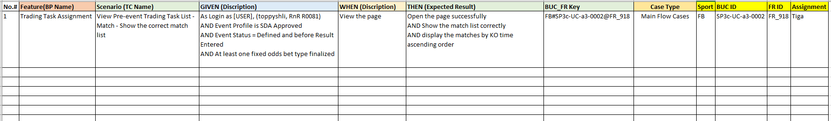
Behavior Test Case Creation – 4/4
Output View:
- Similar QC Import Format with BUC ID & FR ID for Requirement Traceability

Slide 8
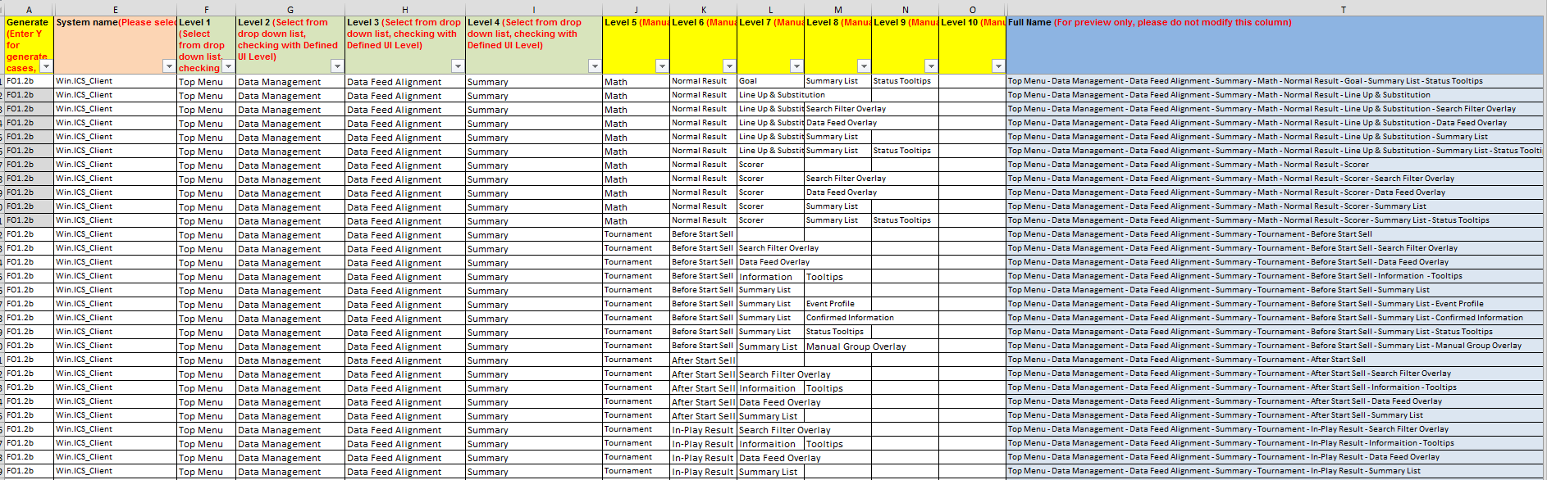
System Test Case Creation - System UI Related Checking (1/4)
System cases focus on different areas:
System UI Related Checking
Football Racing Business Operation Scenarios
R&R Entitlement Checking
System Interface RR/PS Checking
Data Init Checking
System UI Case Input View – Create the UI Checking Area
Design Doc Reference: UI Prototype (Initial Stage), UI Functional Spec, Field Spec, System Error Log List

Slide 9
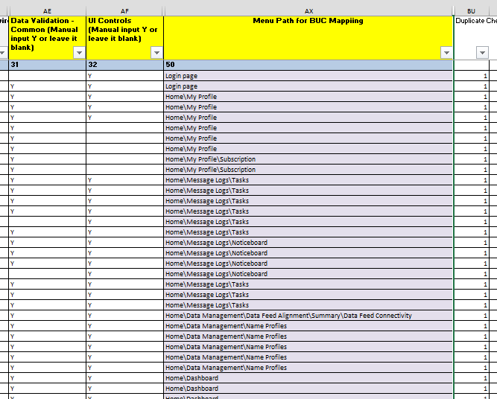
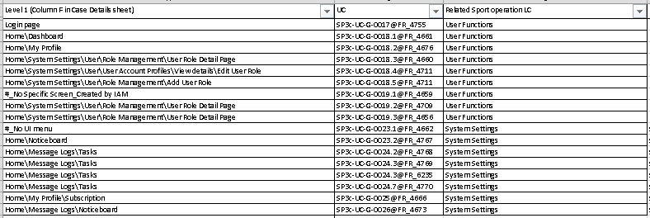
System Test Case Creation - System UI Related Checking (2/4)
System UI Case Input View – Identify the checking focus – Data Validation, UI Control etc
Map with related UI Menu Path for Requirement Traceability

Slide 10
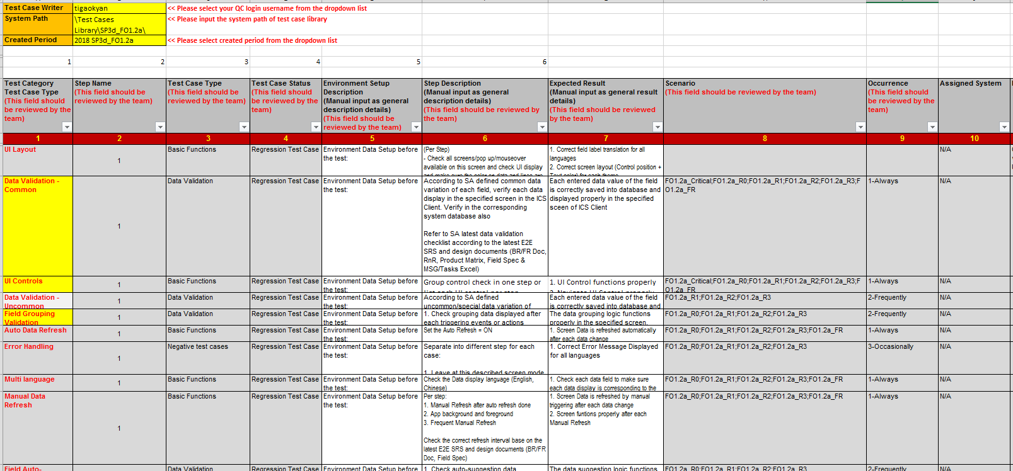
System Test Case Creation - System UI Related Checking (3/4)
System UI Case Input View – Checking Focus Details

Slide 11
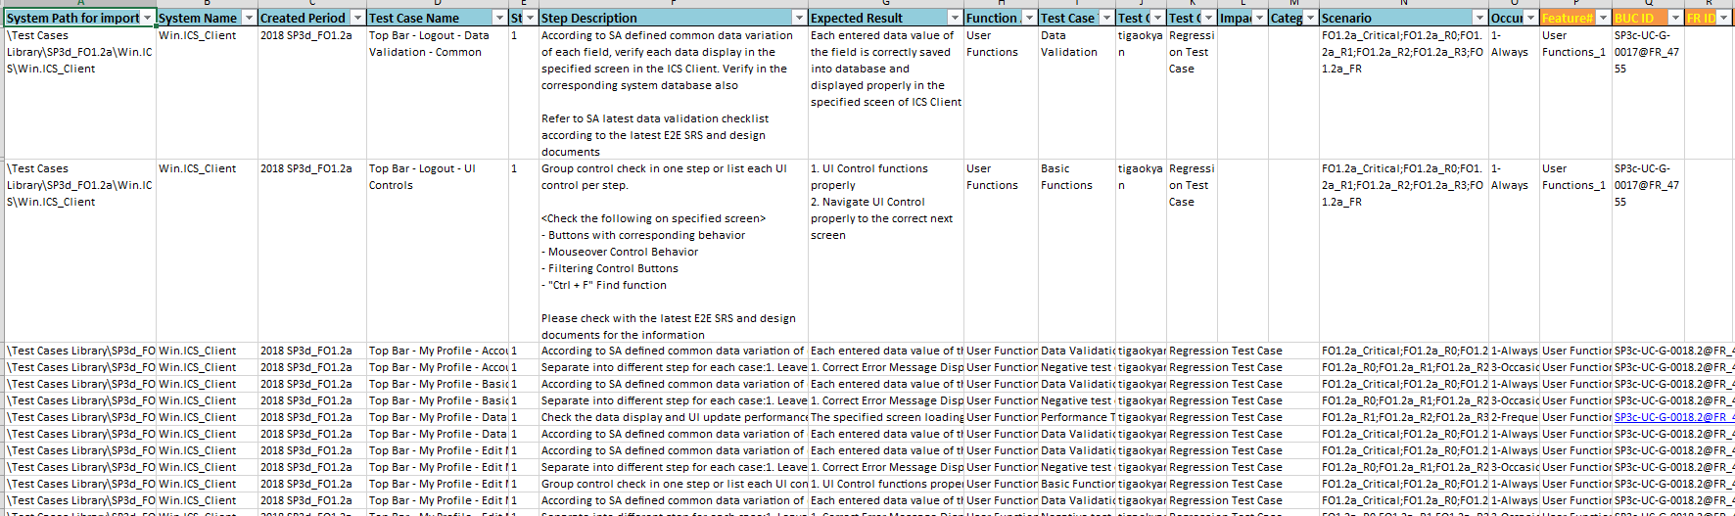
System Test Case Creation - System UI Related Checking (4/4)
System UI Case Output View

Slide 12
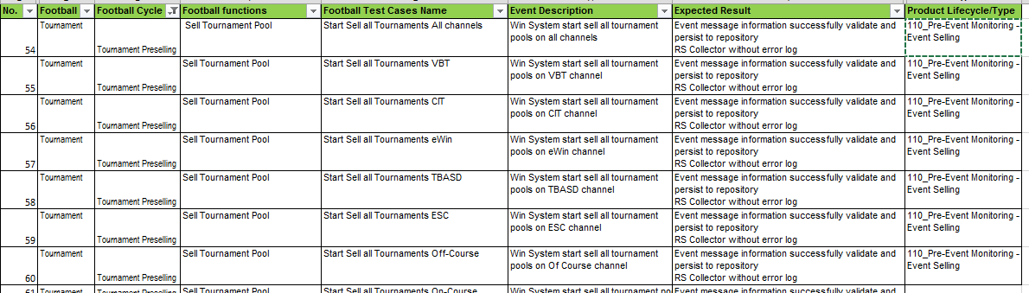
System Test Case Creation - Football Racing Business Operation Scenarios
System cases focus on different areas:
System UI Related Checking
Football Racing Business Operation Scenarios
R&R Entitlement Checking
System Interface RR/PS Checking
Data Init Checking
Football Racing Business Operation Scenarios
Design Doc Reference: Business & Functional Requirement Doc, Product Matrix, SOP from SP3d UAT Team

Slide 13
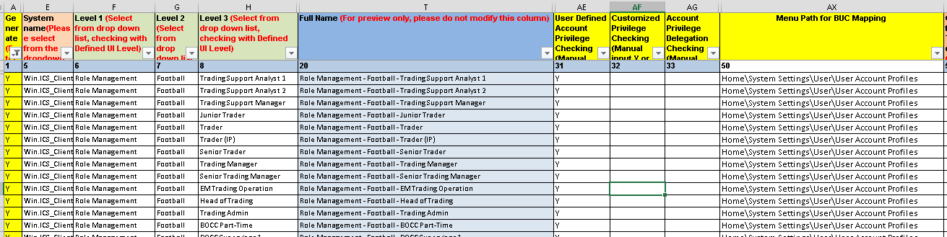
System Test Case Creation - R&R Entitlement Checking (1/3)
System cases focus on different areas:
System UI Related Checking
Football Racing Business Operation Scenarios
R&R Entitlement Checking
System Interface RR/PS Checking
Data Init Checking
R&R Entitlement Checking Case Input View
Design Doc Reference: RnR Matrix, Field Spec, Data Init Files, UI Functional Spec

Slide 14
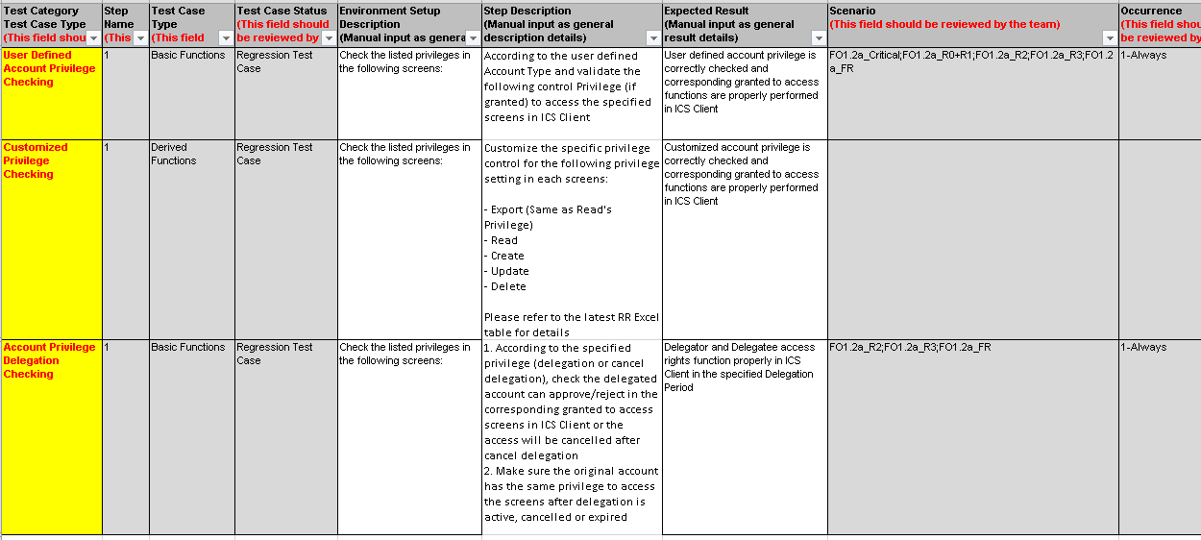
System Test Case Creation - R&R Entitlement Checking (2/3)
R&R Entitlement Checking Case Input View – Checking Focus Details

Slide 15
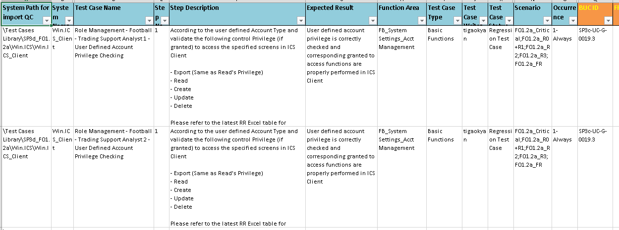
System Test Case Creation - R&R Entitlement Checking (3/3)
R&R Entitlement Checking Case Output View

Slide 16
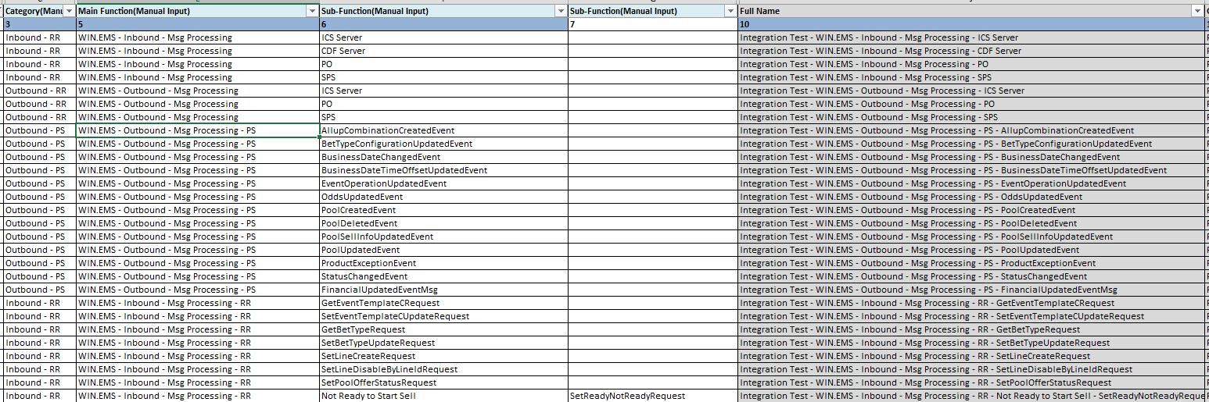
System Test Case Creation - System Interface RR/PS Checking – (1/2)
System cases focus on different areas:
System UI Related Checking
Football Racing Business Operation Scenarios
R&R Entitlement Checking
System Interface RR/PS Checking
Data Init Checking
System Interface RR/PS Checking
Design Doc Reference: SIS, E2E SRS, System Error Log List, System Component SRS

Slide 17
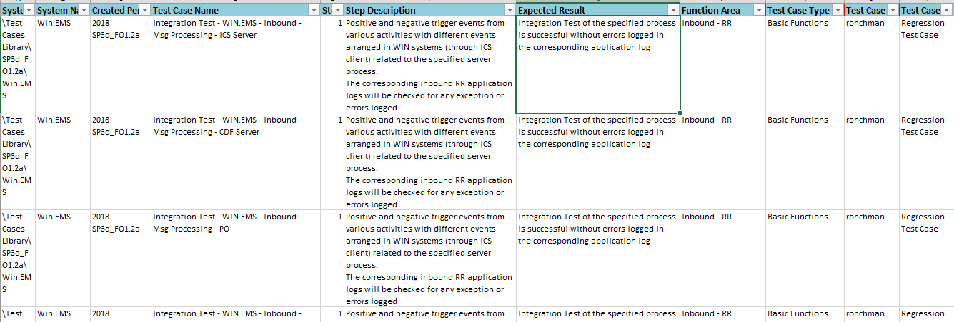
System Test Case Creation - System Interface RR/PS Checking – (2/2)
System Interface RR/PS Checking Case Output View

Slide 18
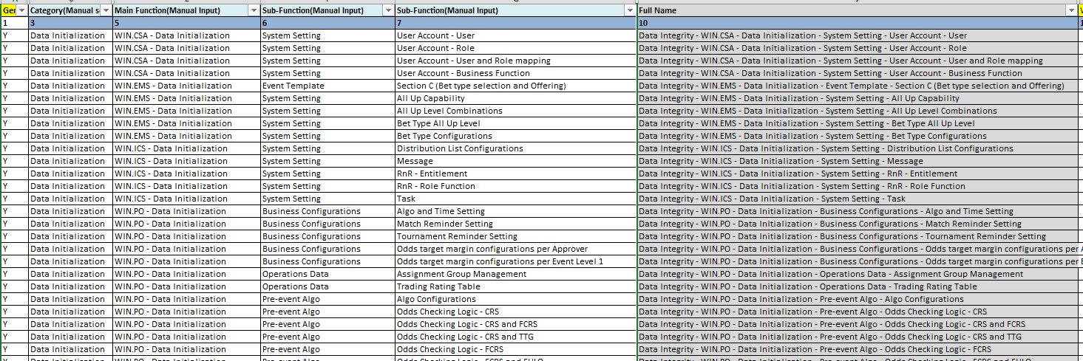
System Test Case Creation - Data Init Checking – (1/2)
System cases focus on different areas:
System UI Related Checking
Football Racing Business Operation Scenarios
R&R Entitlement Checking
System Interface RR/PS Checking
Data Init Checking
Data Init Checking
Design Doc Reference: Data Init Files

Slide 19
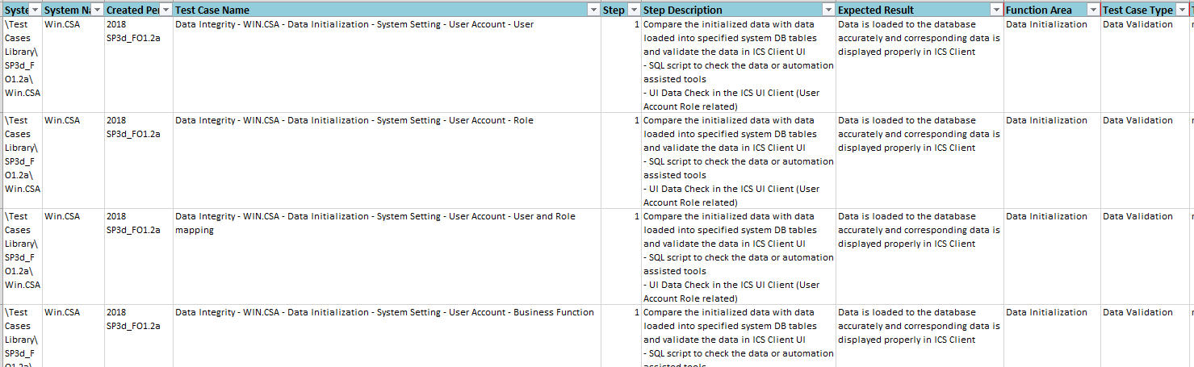
System Test Case Creation - Data Init Checking – (2/2)
Data Init Checking Case Output View

Slide 20
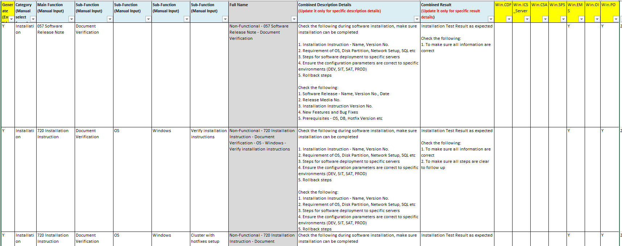
Non-Functional Test Case Creation – (1/4)
Non-Functional Testing - Focus on different areas:
Design Doc Reference: NFR Requirement, System Component SRS, SDD, SCS, ITOG
Non-Functional Test Case Input View

Slide 21
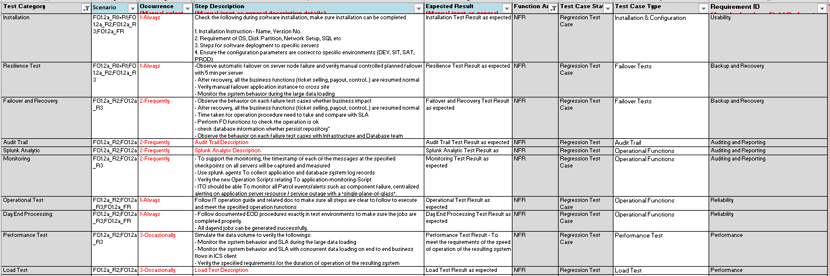
Non-Functional Test Case Creation – (2/4)
Non-Functional Test Case Input View – Checking Focus Details (Part 1)

Slide 22
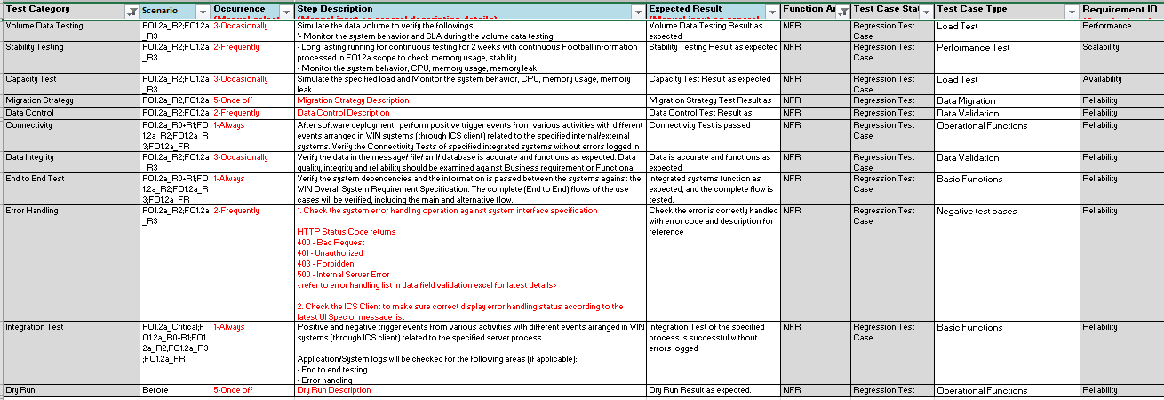
Non-Functional Test Case Creation – (3/4)
Non-Functional Test Case Input View – Checking Focus Details (Part 2)

Slide 23
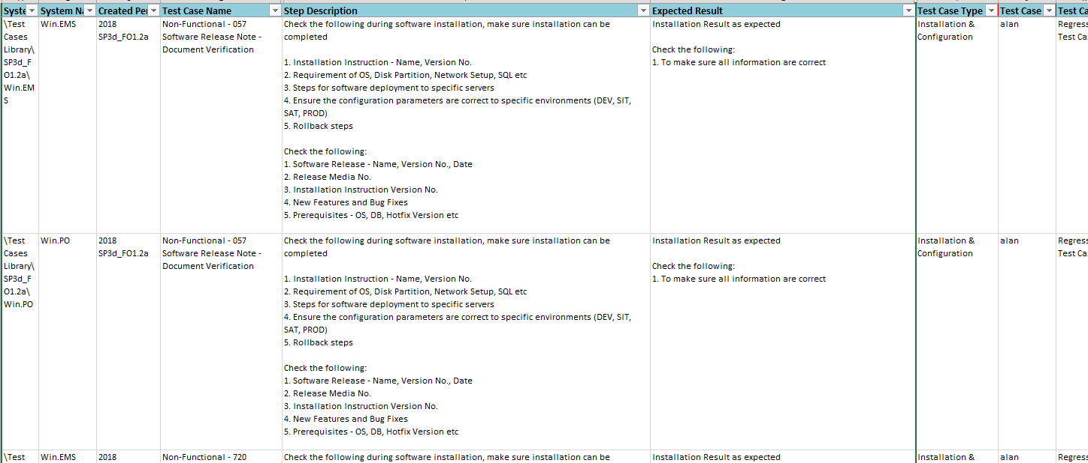
Non-Functional Test Case Creation – (4/4)
Non-Functional Test Case Output View

Slide 24
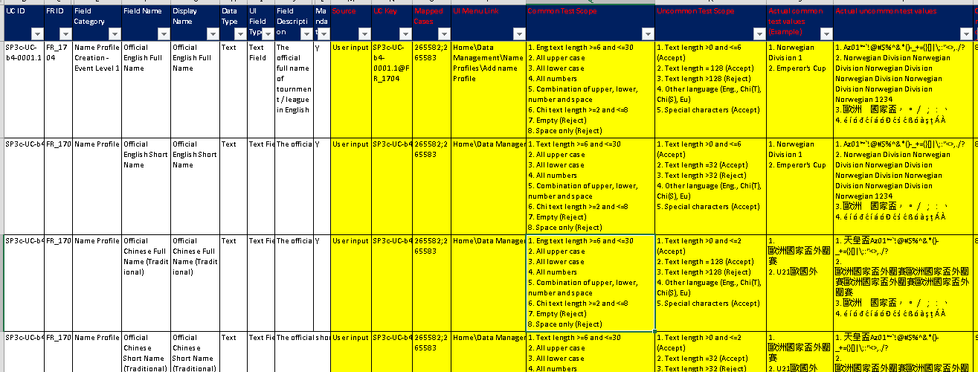
Data Preparation From Testing Design

